Slide 1
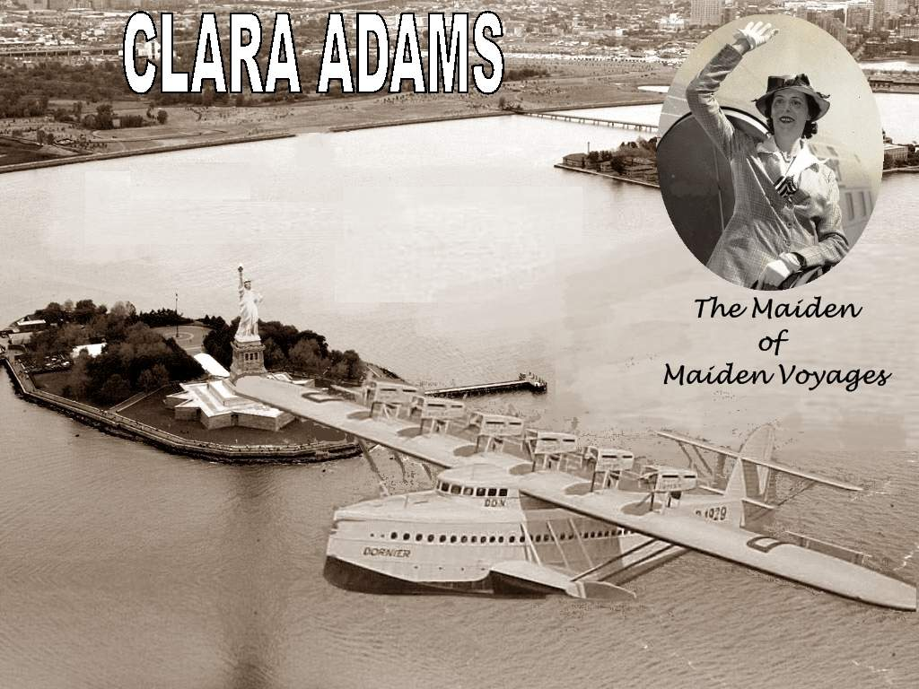

She was the only paying woman passenger on the flight of Germany’s massive, twelve-engined Dornier DO-X flying boat from Rio de Janeiro to New York, in 1931.
Music: "Another Story" by Jill Daniels

Slide 2
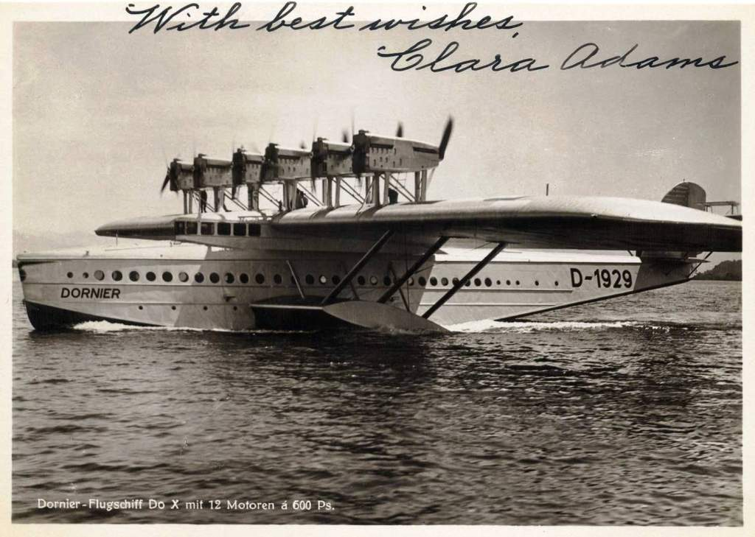
Of the trip, Adams noted: “I could write a good-sized book were I to tell all the wonders that crowded into those six thrilling weeks.”

Slide 3
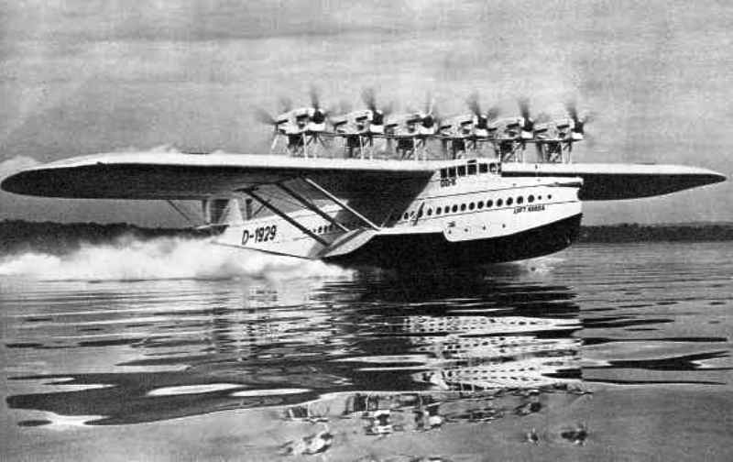
In 1931, Adams boarded a Pan Am Clipper headed from New York to Rio de Janeiro just to become the only woman passenger on the Dornier DO-X on the trip back to New York. The DO-X was an enormous, slow and heavy flying boat that hopped up the South American coast, stopping frequently.

Slide 4
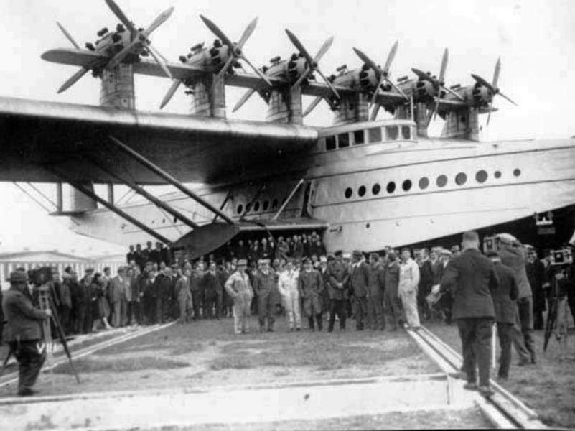

Slide 5
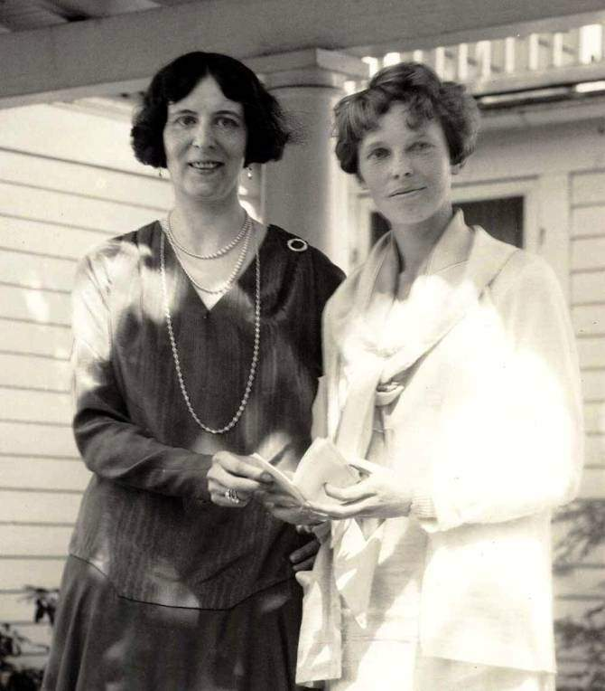
CLARA
ADAMS
AMELIA
EARHART

Slide 6
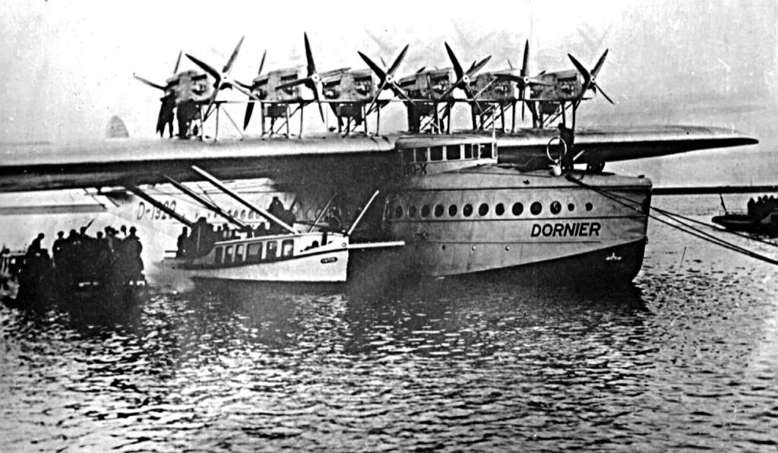
The aircraft was conceived by Dr. Claudius Dornier, starting in 1924, and took seven years to design and another two years to build. .
It was financed by the German Transport Ministry and was manufactured in a specially designed plant at Altenrhein, on the Swiss portion of Lake Constance, in order to circumvent the Treaty of Versailles, which forbade aircraft to be built in Germany after World War I.

Slide 7
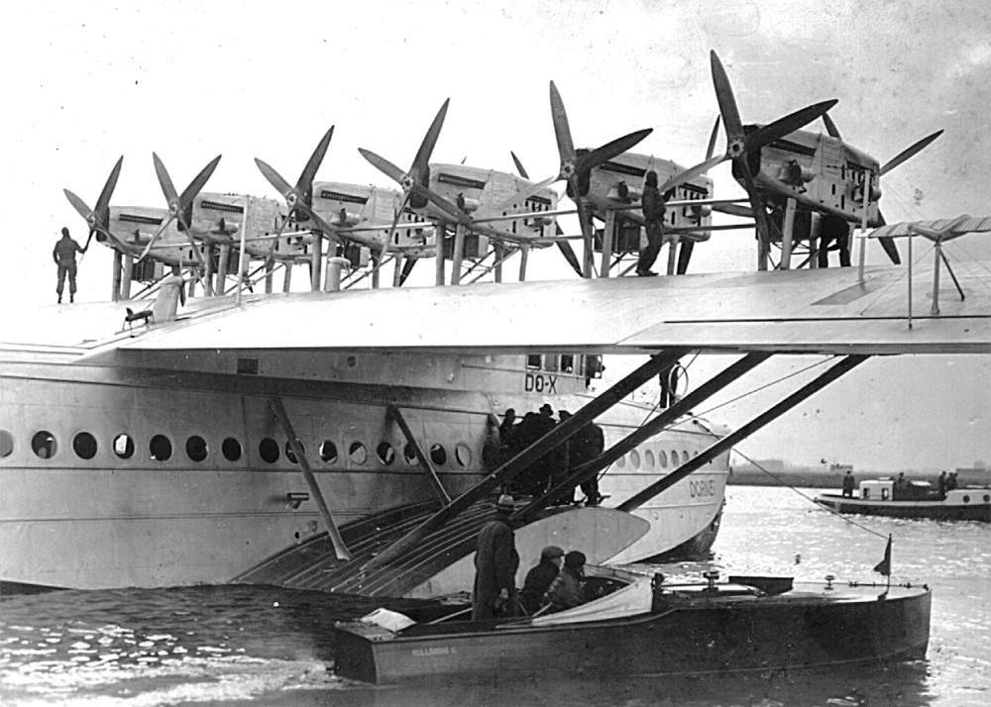
On the main deck was a smoking room and wet bar, a dining salon, and seating for the 66 passengers, which could be converted to sleeping berths for night flights. Aft of the passenger spaces was an all-electric galley, lavatories, and cargo hold. The cockpit, nav station, engine and radio rooms were on the upper deck.

Slide 8
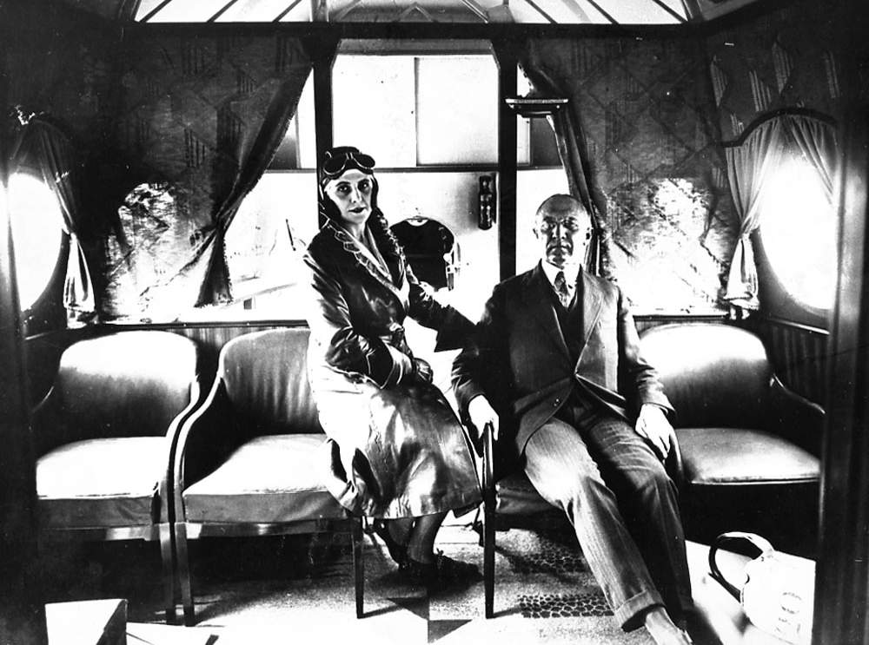
Lady Grace Drummond-Hay and Karl vonWiegand aboard the Dornier DO-X flyingboat.

Slide 9
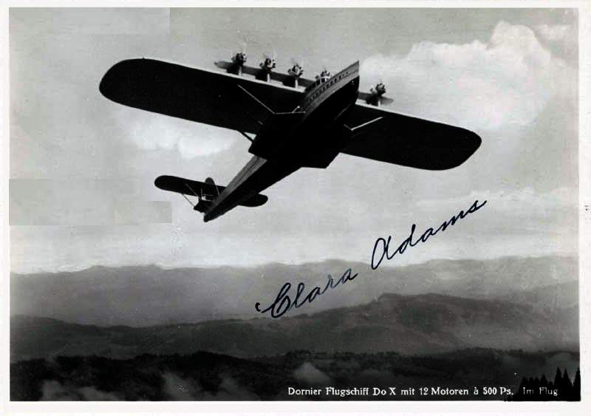
Postcard signed by Clara. During one flight she managed to mail more than six
pounds of letters and postcards. She referred to herself as 'Persistant First Flyer.'

Slide 10
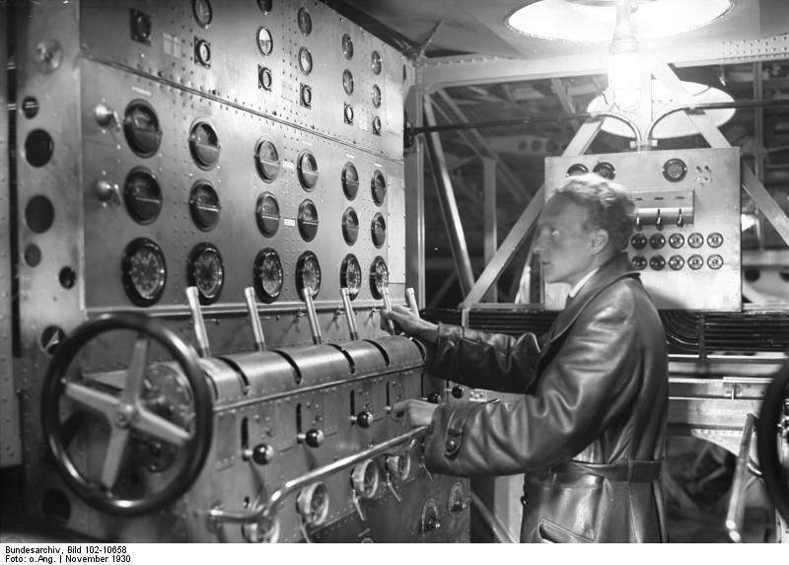
The engine control room was on the top level of the DO-X as well as as the cockpit,
navigation and radio rooms. Cruise speed was a little over 100 mph.

Slide 11
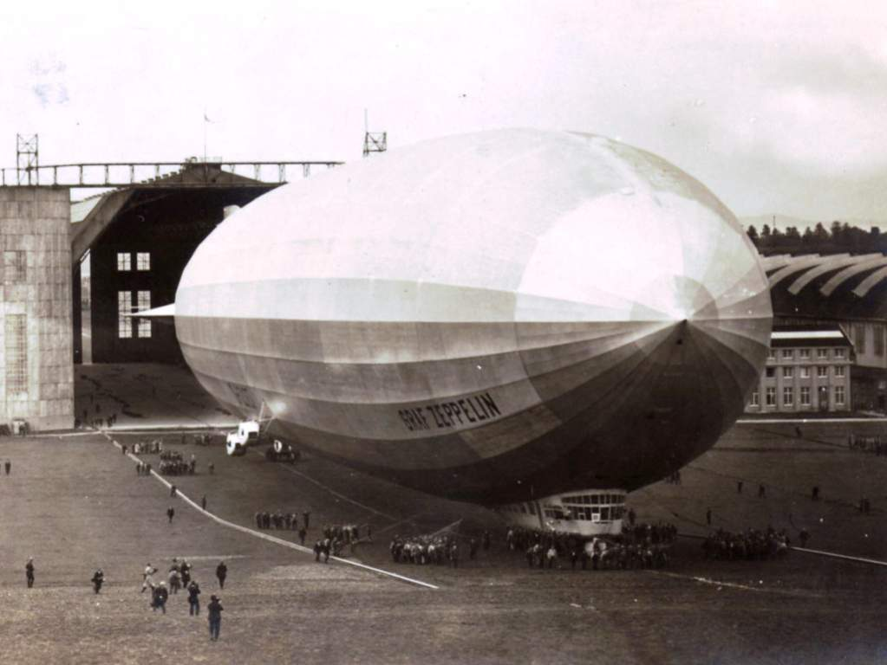
"The most notable flight took place, when in 1928 the Graf Zeppelin made its pioneer round trip- from Europe to the U. S. A. and return. It was my privilege to buy the first ticket ever sold to a feminine passenger to fly across the Atlantic. It cost $3,000. On this pioneer flight from the U. S. to Europe, there were 64 men and one woman aboard. I was that lone woman. It turned out to be the most hazardous trip ever experienced by the Zeppelin officers and crew even to the present day. 71 hours, the flight lasted." - Clara
Graf Zeppelin being led from its hangar for its first flight on
September 18, 1928 inFriedrichshafen. Germany .

Slide 12
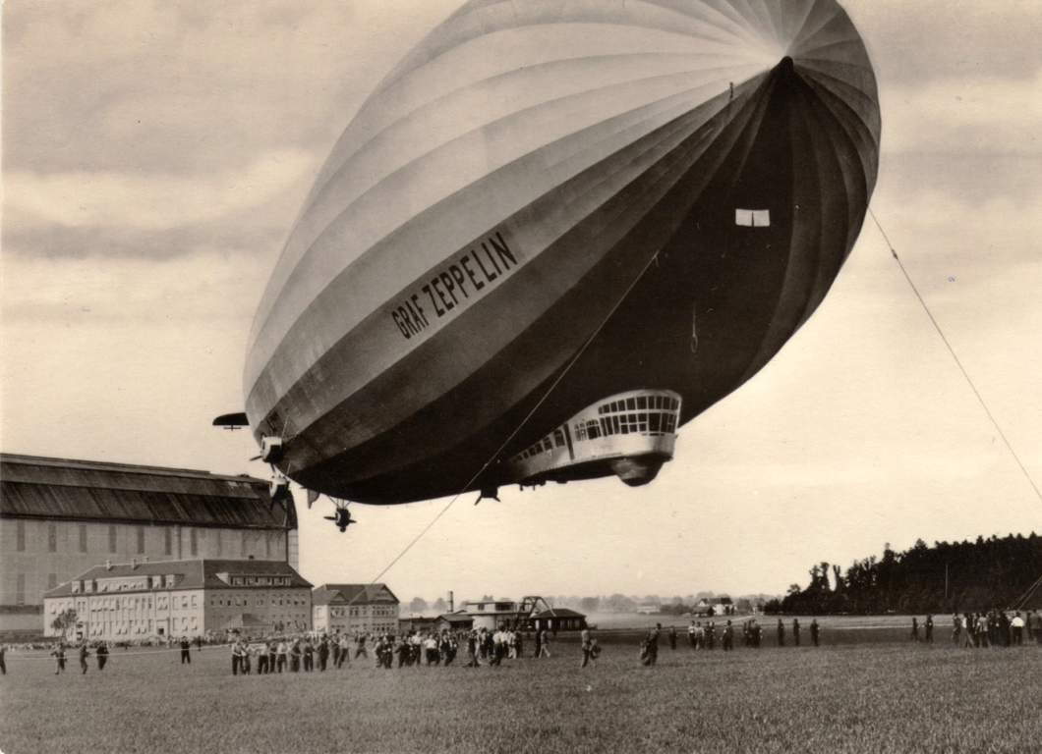
The German built Graf Zeppelin LZ-127 would later become the USS Los Angeles

Slide 13
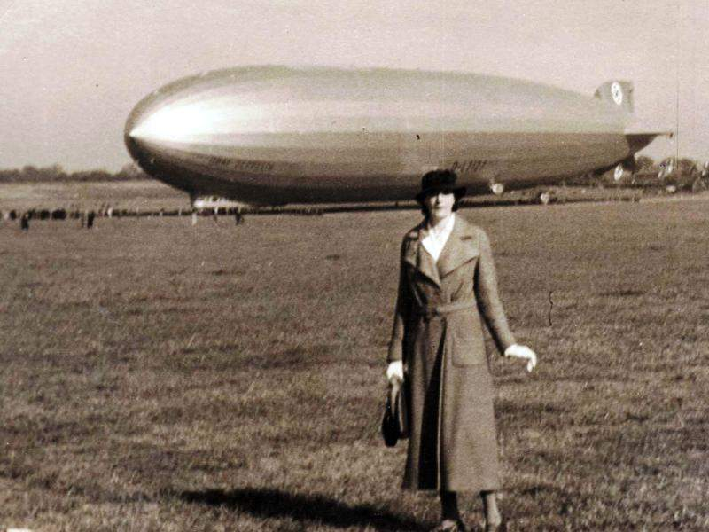
In 1928, Adams purchased the first transatlantic air ticket ever sold to a female passenger, and was on the first flight of the airship Graf Zeppelin from North America to Europe in October, 1928.

Slide 14
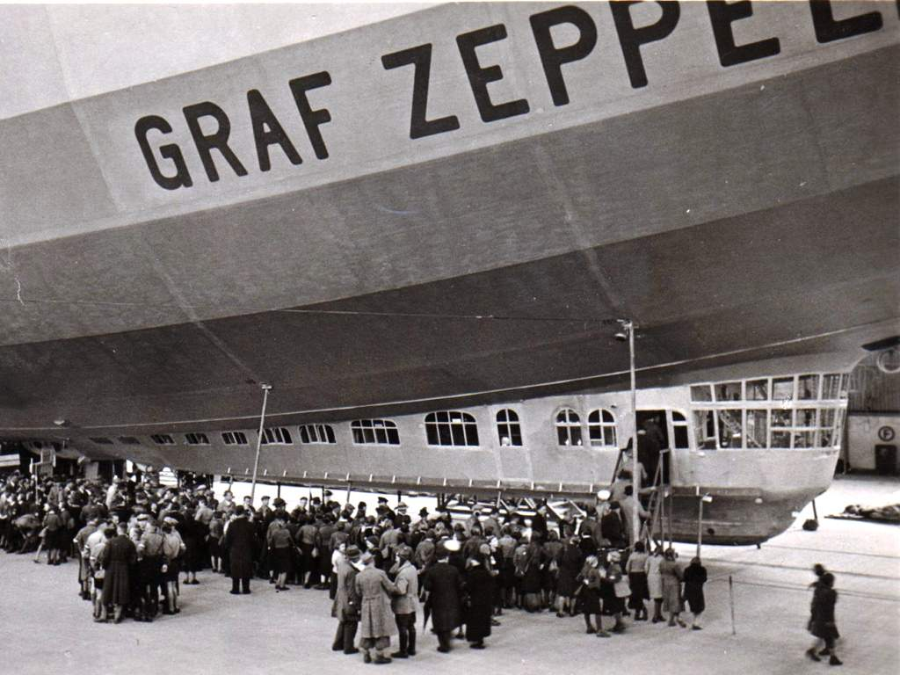

Slide 15
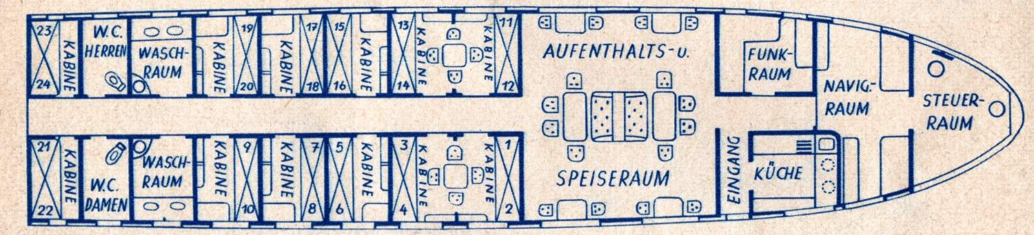
Colonel Klink was just here,
funk raum is radio room
Overall length 98 ft.

Slide 16
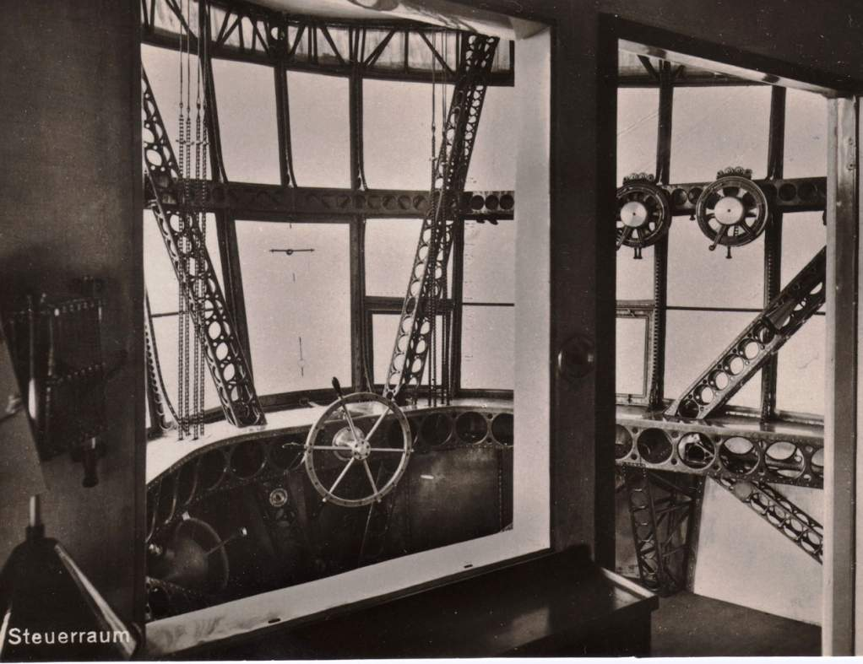
Graf Zeppelin Steuer Raum

Slide 17
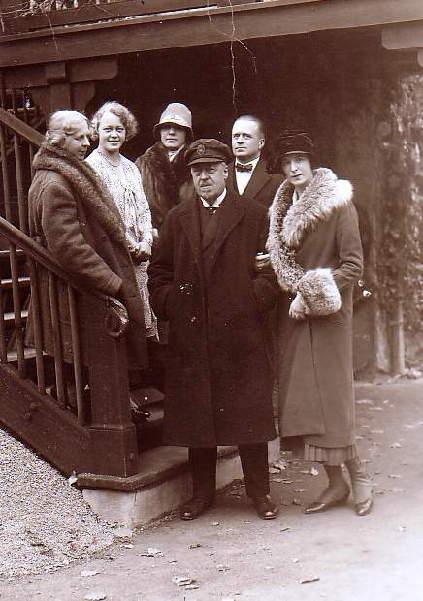
Born in Cincinnati, Adams got hooked on flying after her first experience, in a Thomas flying boat in 1914 at Lake Eustis, Fla.
When she bought a ticket on the Graf Zeppelin, a round-trip fare from the U.S., in 1928 it was the first air ticket sold to a woman
passenger to cross the Atlantic.
“The $3,000 it cost her to fly round trip on the Graf Zeppelin’s pioneer flight was the equivalent of
several years’ salary for the average person in those days,”
said Friedman.
(It would be more than $136,000 today.)
Clara Adams with Dr. and Mrs. Hugo Eckener in Friedrichshafen, November 3, 1928, after arriving from North America aboard Graf Zeppelin.

Slide 18
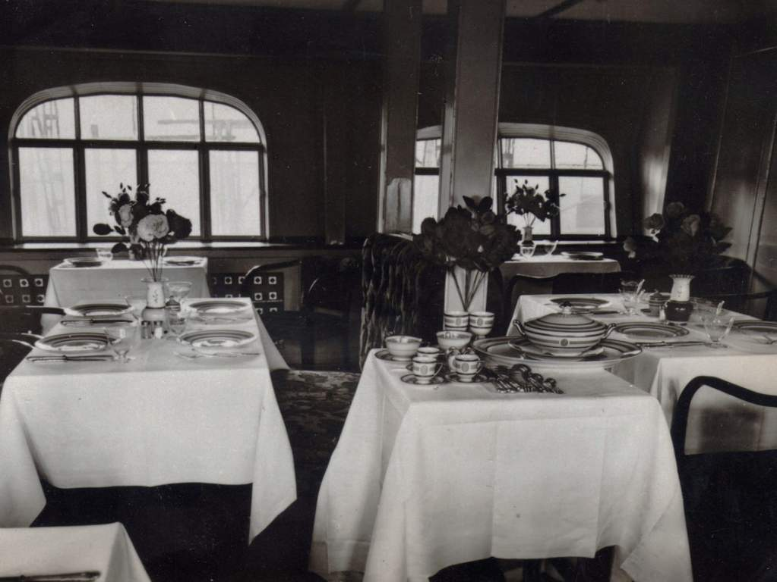
No paper, plastic or styrofoam!

Slide 19
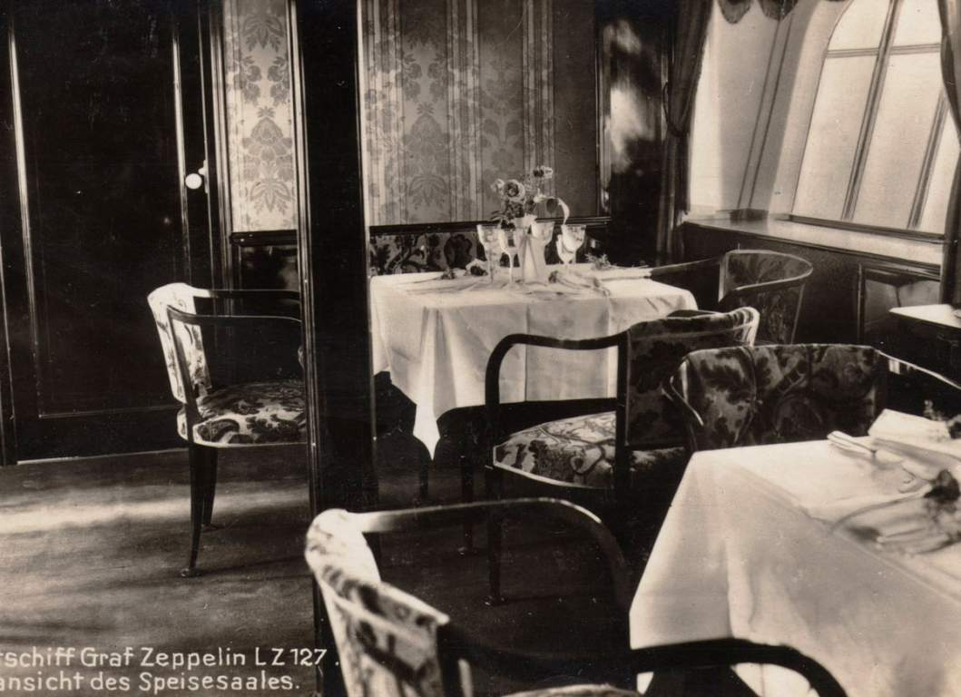

Slide 20
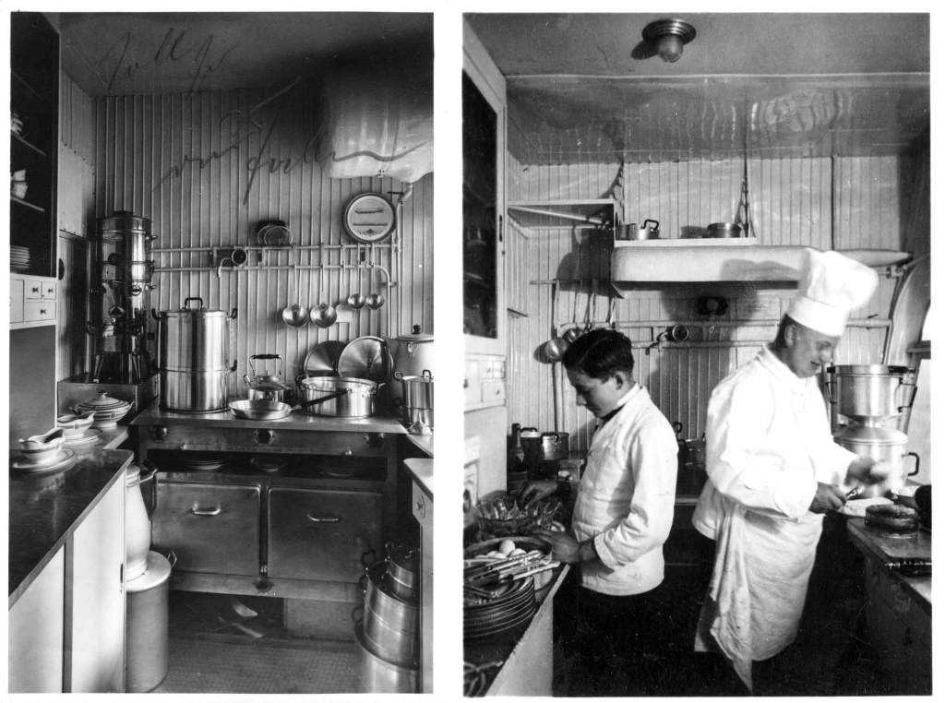

Slide 21
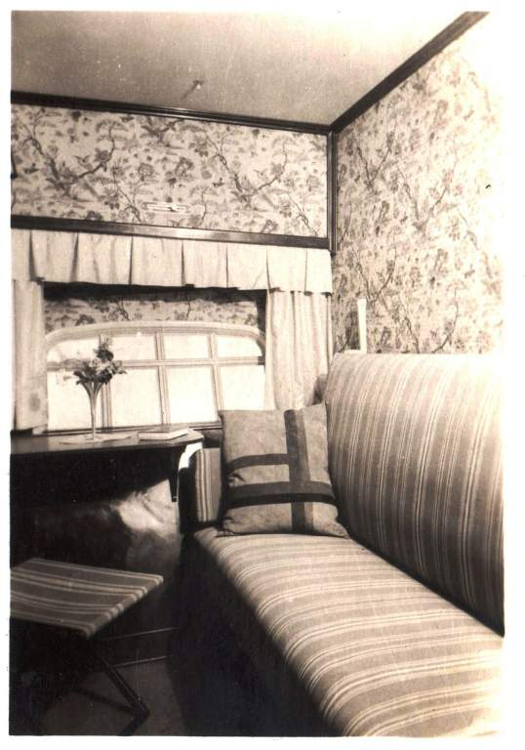
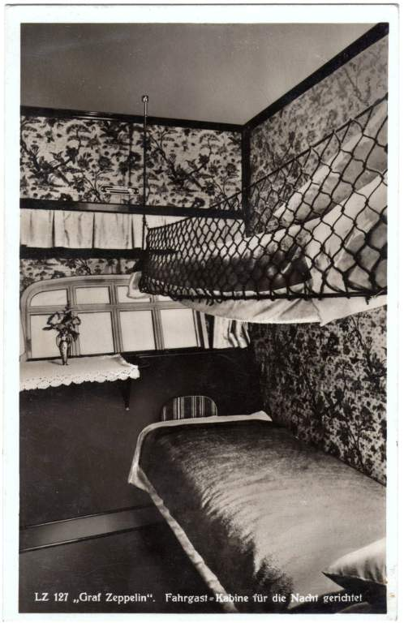

Slide 22
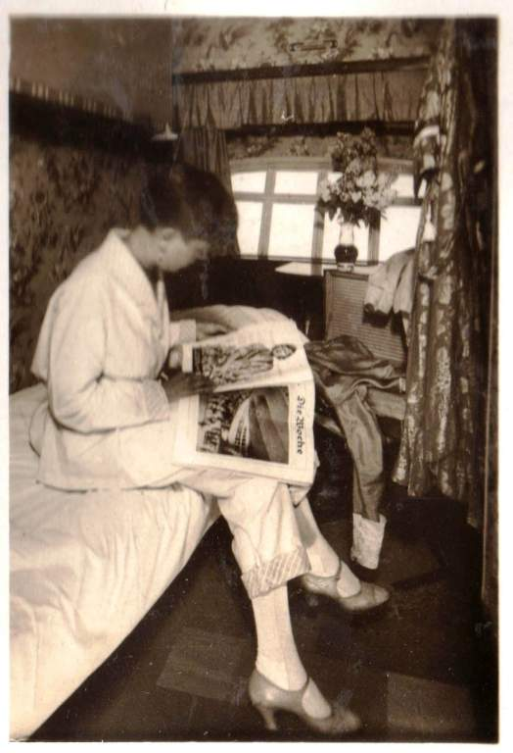
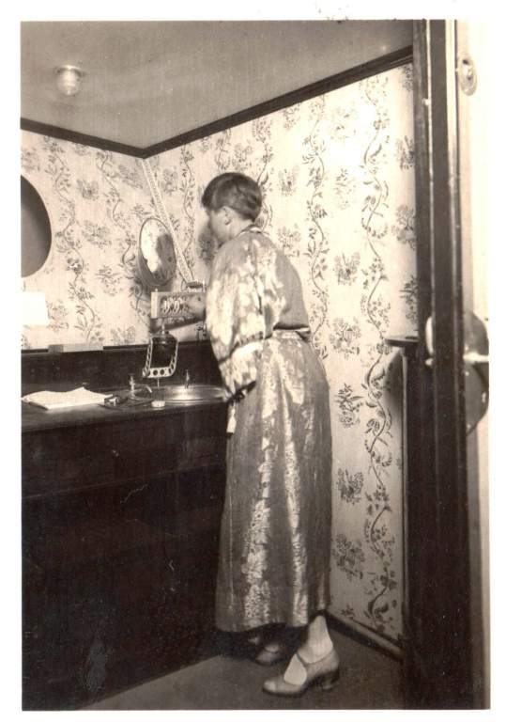

Clara's
favorite
award

Slide 23
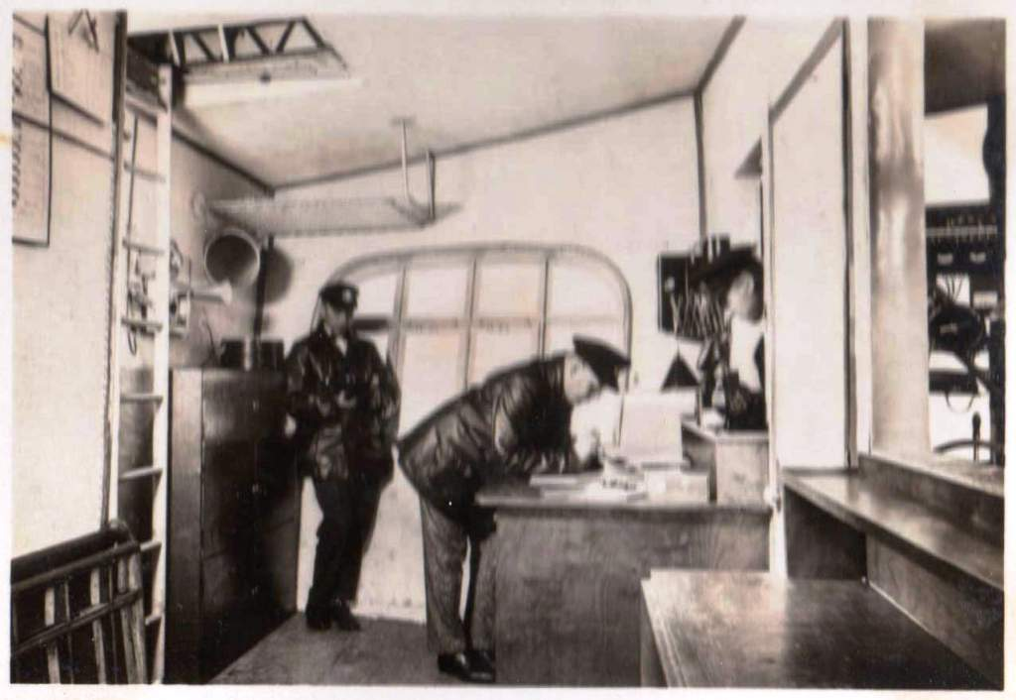
NAVIGATION RAUM - AFT OF THE STEERING RAUM
FORWARD OF THE FUNK RAUM

Slide 24
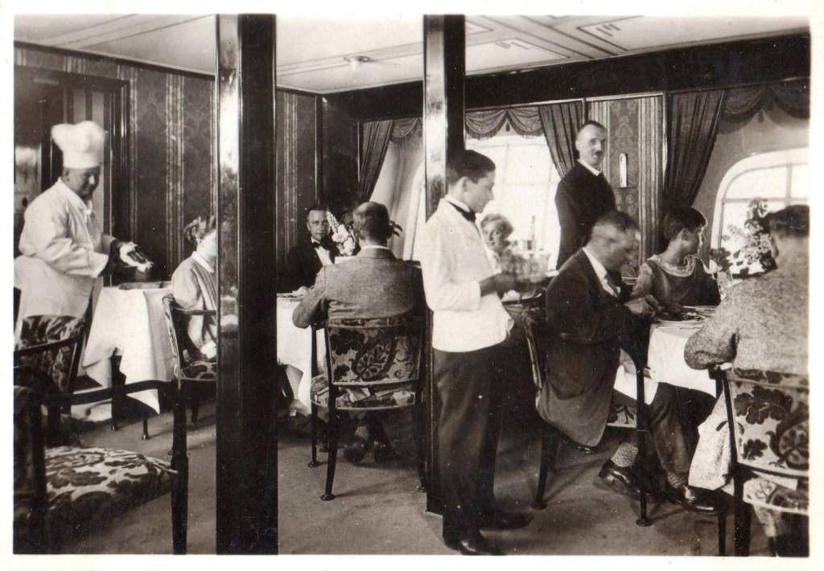

Slide 25
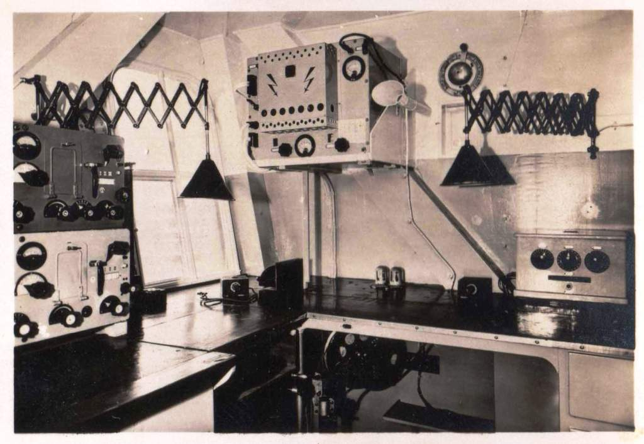
DER FUNK RAUM

Slide 26
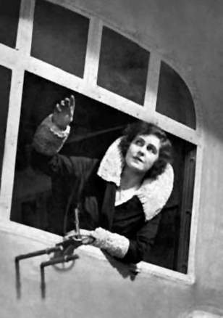
Lady Grace Drummond-Hay, a journalist, was aboard the Graf Zeppelin on the delivery trip to the US.
While the surroundings were luxurious, they were also unheated, and during the winter months, or when the ship flew over the North Atlantic, or during the flight over Siberia as part of the 1929 Round-the-World flight, passengers often spent much of their time wrapped in heavy winter coats or covered by layers of blankets while ice crystals formed on the windows.

Slide 27
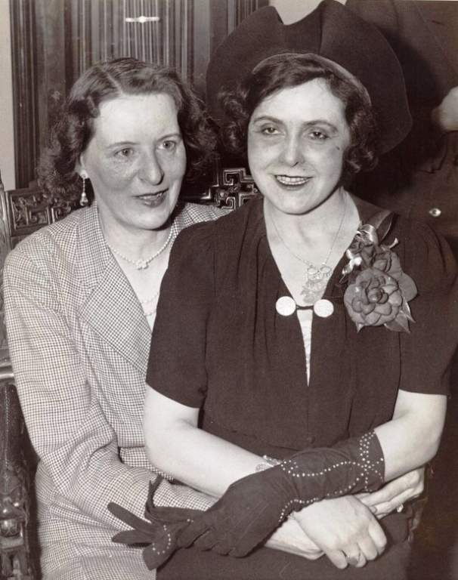
Clara Adams & Lady Grace Drummond-Hay
As frequent passenger Lady Grace Drummond-Hay described it:
We have a million cubic feet of gas but no heat. . . . Merciless cold driving through the canvas walls
of this flying tent. … I have visualized myself gracefully draped over a saloon window ledge romantically viewing the moonlit sky.
The men . . . have reminded each other not to forget evening jackets and boiled shirts in their baggage. We have drawn ourselves lovely pictures of dining elegantly in mid-air with Commodore Eckener at the head of a flower-decked table . . . but . . . leather coats, woollies and furs will be our evening dress.
Hot soup and steaming stew more welcome than cold caviar and chicken salad.

Slide 28
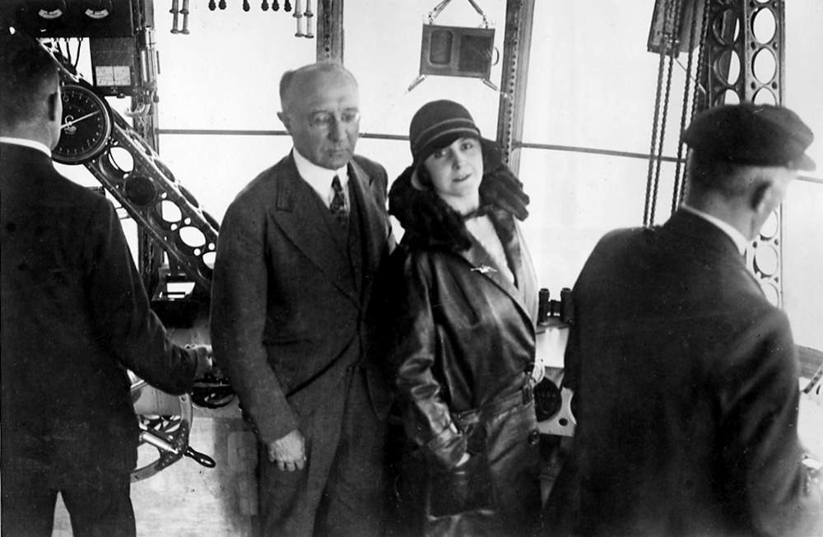
Grace Drummond-Hay and Karl von Wiegand in control car of LZ-127 Graf Zeppelin

Slide 29
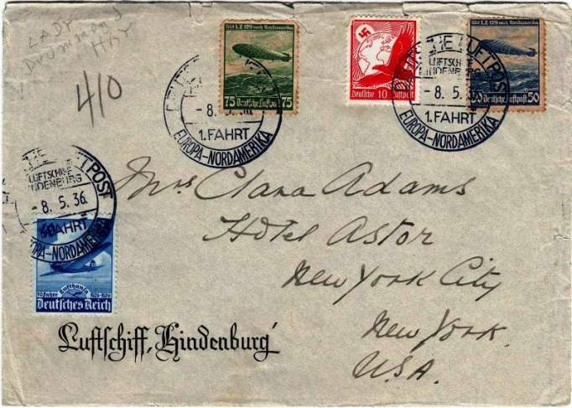
Clara Adams was on the inaugural flight of the dirigible Hindenburg in 1936.
After the Hindenburg crashed in New Jersey in 1937, Adams wrote to company officials in support and purchased a ticket for a next flight that never took place.
DRUMMOND-HAY COVER FOR THE HINDENBURG HISTORIC FLIGHT
(No street address, no zip code, no state needed. She received it.)

Slide 30
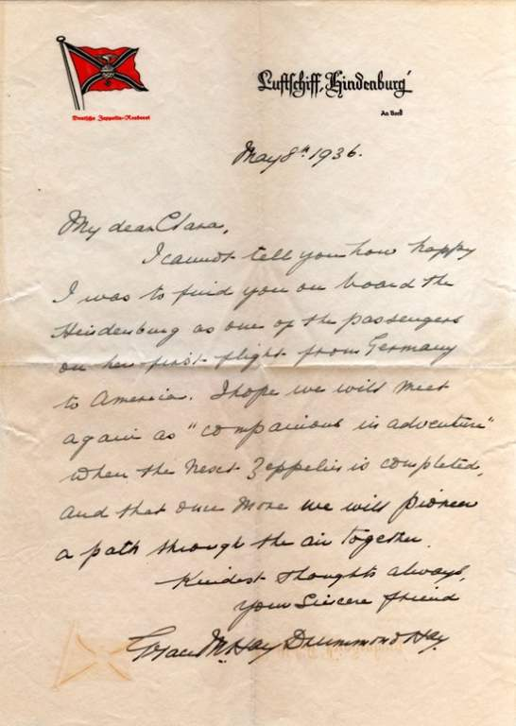

The letter is dated is dated May 8, 1936; the age of the passenger zeppelin ended just a year later, with the Hindenburg disaster of May 6, 1937.
My dear Clara:
I cannot tell you how happy I was to find you on board the Hindenburg as one of the passengers on her first flight from Germany to America. I hope we will meet again as “companions in adventure” when the next Zeppelin is completed, and that once more we will pioneer a path through the air together.
Kindest thoughts always,
your sincere friend,
Grace M Hay Drummond Hay

Slide 31
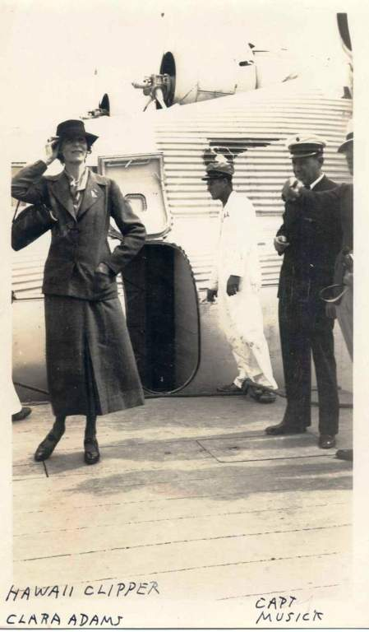
“Personally, I think that the amazing variety of trips and flights Clara Adams took are remarkable, considering the pioneer nature of early aviation in the 1920s and 1930s,” said Thomas Allen, curator of special collections in the History of Aviation Collection at the University of Texas-Dallas.
UT-Dallas has Clara Adams memorabilia including photos, letters and post cards.

Slide 32
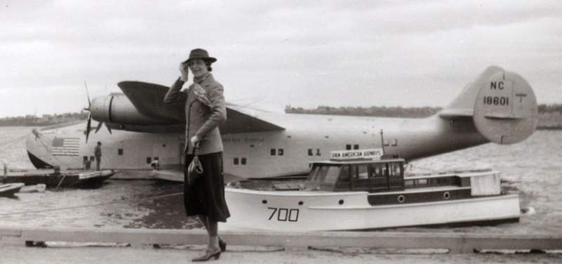
Clara Adams helped change the public perception of aviation from a dangerous enterprise for daredevils in leather helmets to something that could be enjoyed by a little old widow from Pennsylvania.
Her round-the -world flight in 1939 was a very public demonstration of just how far aviation had come in so short a time; Charles Lindbergh had crossed the Atlantic in May, 1927, and just twelve years later it was possible for a woman to buy a ticket to fly around the world on scheduled airlines.
And Clara Adams made sure the world knew it.

Slide 33
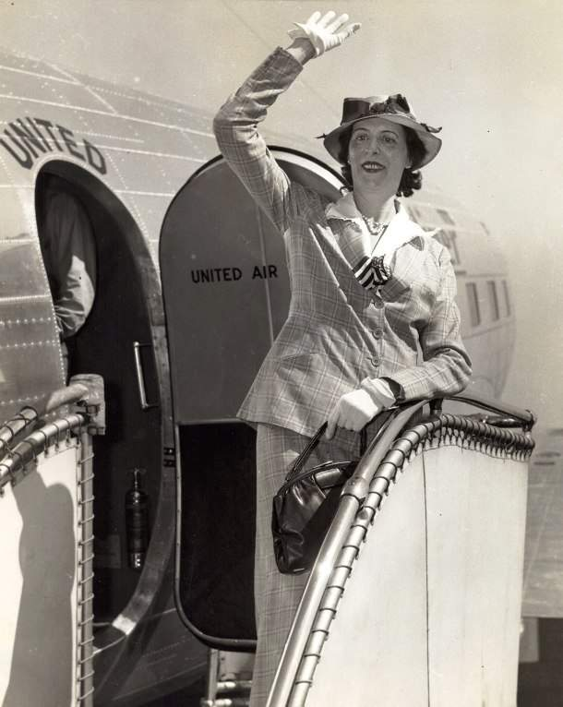
Clara always paid her way.
She took photos and bugged
aircrew members for their
autographs.
She collected boxes and more
boxes of the collectible items
from the time.
She used her own money to
make promotional tours and
talks.
An autobiographical record of her travels concludes:
“I want it understood that in
what I have written, I am
merely stating facts with
no intention of boasting.”

Slide 34
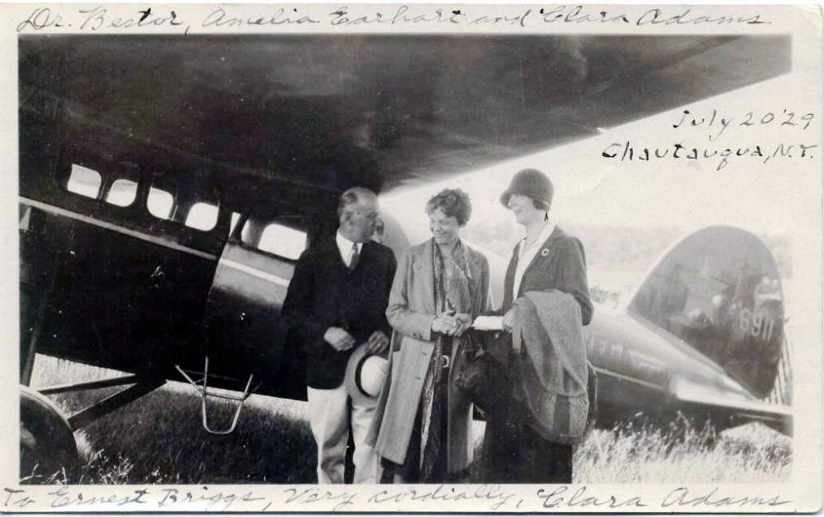
She was aboard the first flights of many celebrated airships, flying boats, and early airliners, and she became acquainted with many of the famous aviators of the day, including Amelia Earhart. Her friend, Grace Drummond-Hay & Karl von Wiegand were in the Phillipines when the Japanese invaded the islands in 1942, and both were interned in a Japanese camp.

Slide 35
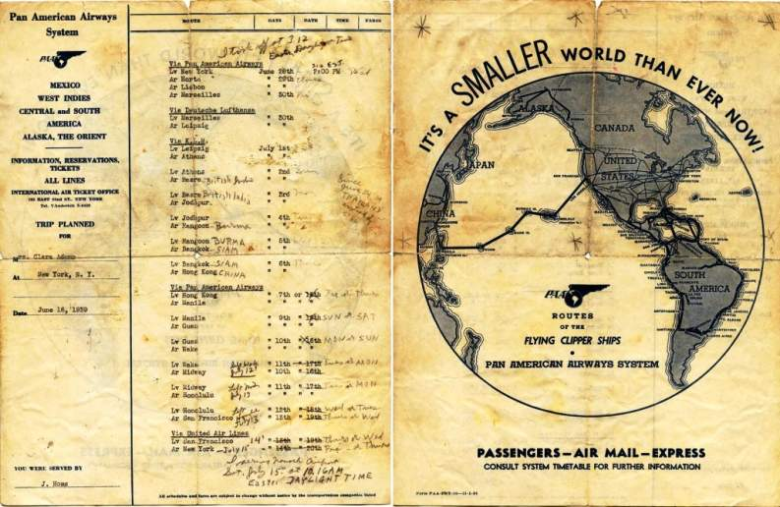
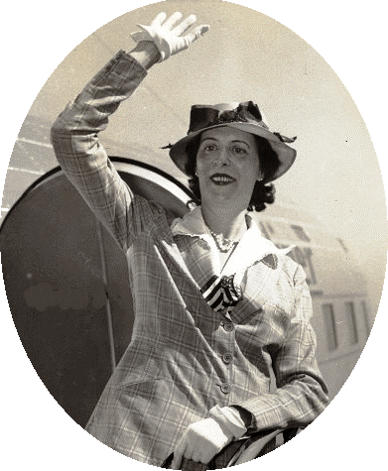


In 1939, Clara Adams became the first woman air passenger to circle the world. It took 16 days, 19 hours, 8 minutes and 10 seconds.
Overall, she logged more than 150,000 maiden-voyage miles.
Her final flight to have her ashes scattered
from a plane was carried out per her wishes.
Her resting place is vaguely recorded as “the ocean,”
SEE YA
crkshot

